Slide 1
Exploring Stocks performance forecast on Canadian banks
With a focus on
Bank of Nova Scotia (Scotiabank)
Bank of Montreal (BMO)
Toronto-Dominion Bank (TD Bank)
Royal Bank of Canada (BMO)

Slide 2
Motivation and Background
I recently got a job offer from two competing banks in the Canadian Financial services space and I was faced with a problem of deciding which of the banks to accept its offer. So, after a very detailed research on the banks work culture and growth progression it all came down to the stock options which both banks offered. I had to figure out which bank had the better performing stock and could benefit me in the long-run.
As Fintech students who will mostly change jobs after or during this program, some of us will get job offers from competing companies in the same industry and making the choice on which company to pick might boil down to how the company itself is performing in the market, so as a group we all decided that this will be an interesting project to work and hopefully be able to help our pairs make informed decisions.

Slide 3
Main Questions
Make a graphical representation of the closing pricein 6 years
Summary statistics of the banks
Determine bank performance in the next 5 years
compare performance of banks with S&P 500
Determine the best and least performing banks

Slide 4
Data Source
We used Google Finance as an API and extracted Historical data for four of the most common banks in Canada which are Scotiabank, TD Bank, BMO and RBC.
For this project we only focused on data from the last 6 years (2016-2021)
We dropped all the errors and NAN values our data had. We also dropped the columns we wouldn’t be needing for this project.
We also presented the data in graphs to ensure we have the correct dataset.*

Slide 5
Exploratory Analysis
We imported the CSVs as Pandas Dataframe
We combined the dataframe and sorted out the index
We used Pandas library to perform data clean up
We cleaned the dataframe by dropping all the NAN values
We described the dataset to get the the mean and standard deviation of the dataframe
We renamed each columns to describe each banks closing price

Slide 6
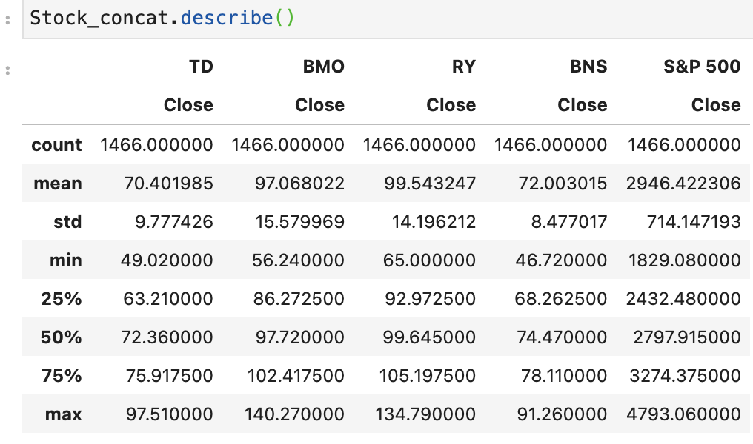
Summary Statistics for the banks

Slide 7
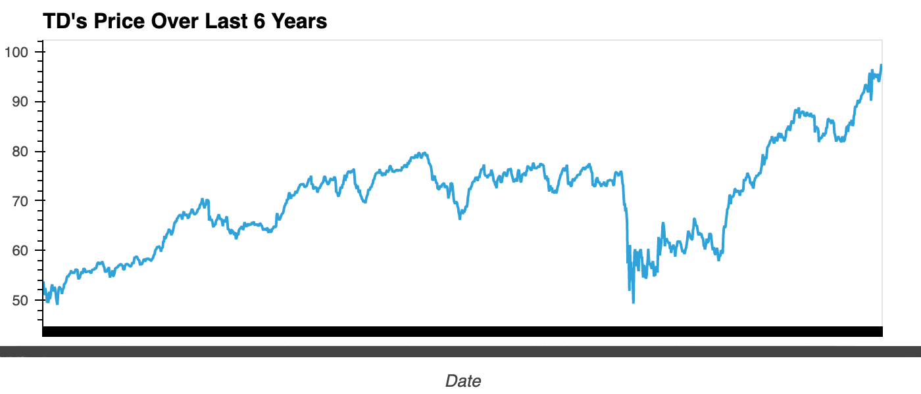
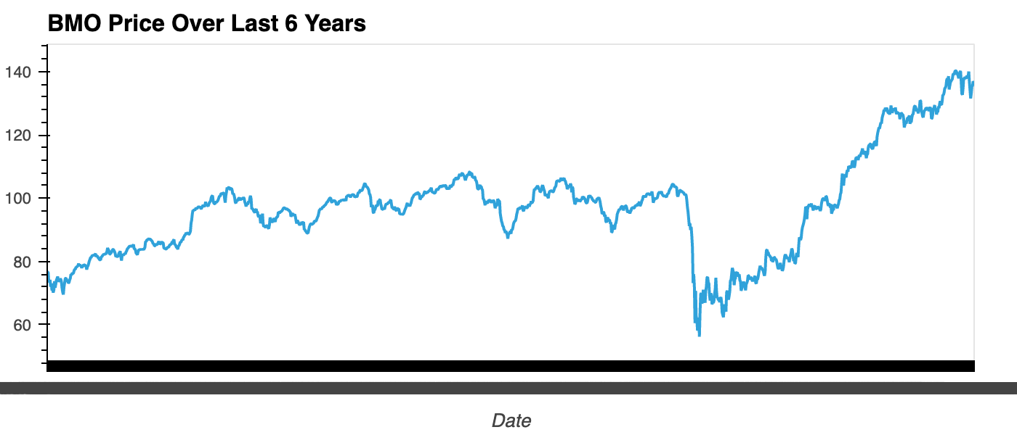
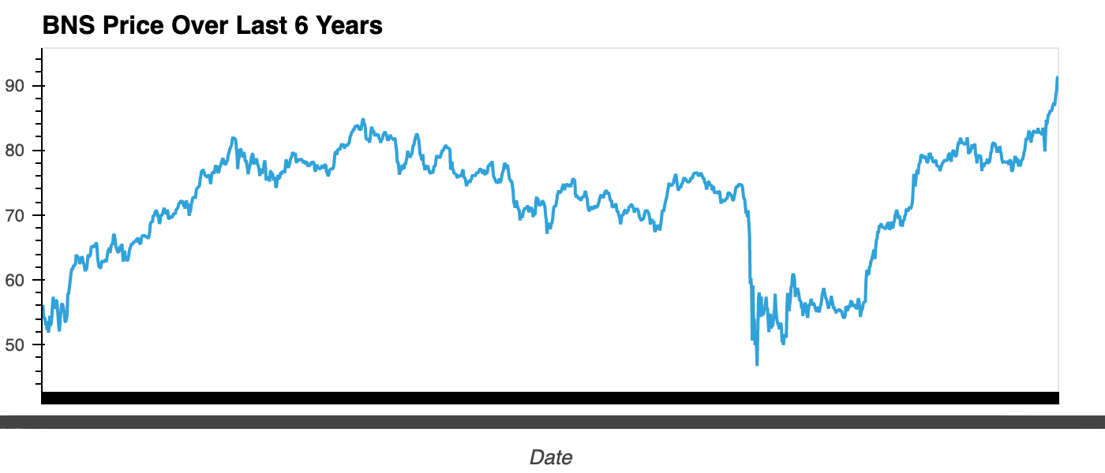
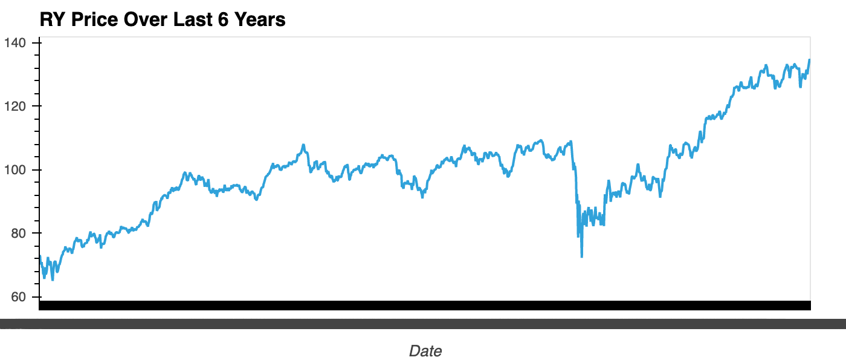
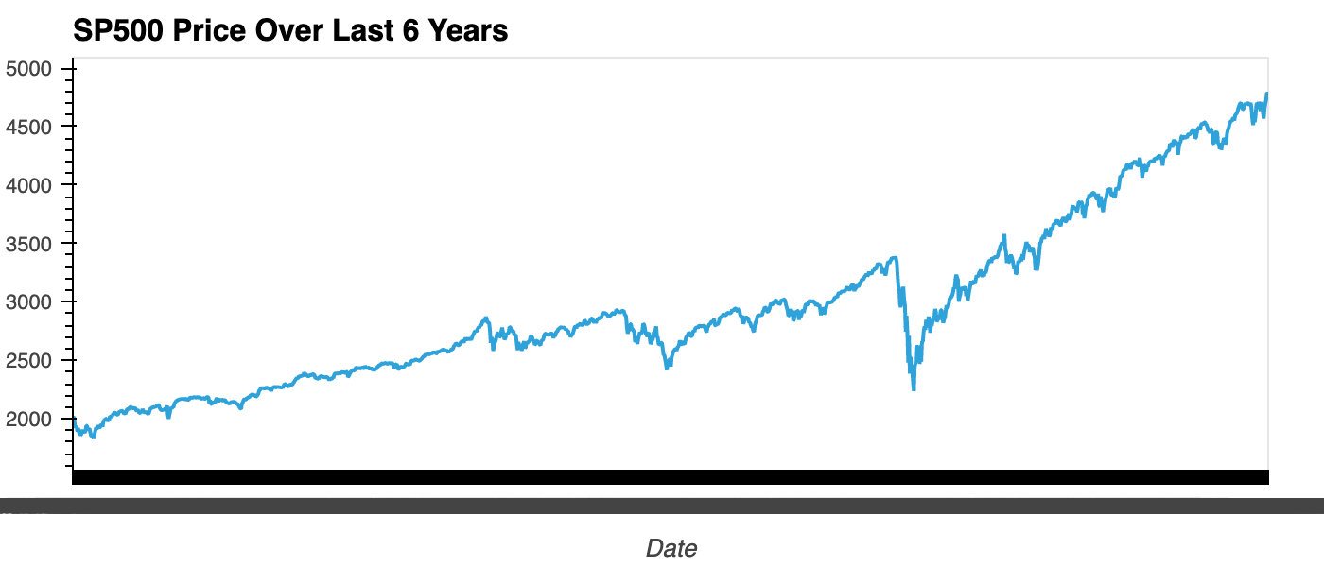
Closing price for the last 6 years

Slide 8

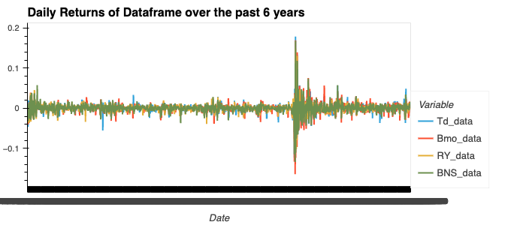
Bank performance in the past 6 years
This shows the daily returns of all the banks from 2016-2021

Slide 9
Bank performance in the next 5 years
Using the Monte Carlo Simulation, we were able to determine the range of return to be expected in 5 years if an individual decides to invest $10000 today in each of the Canadian bank’s stocks, given a 95% confidence interval.
And these are the results;
There is a 95% chance that an initial investment of $10,000 in the BMO over the next 5 years will end within in the range of $6021.42 and $42968.85.
There is a 95% chance that an initial investment of $10,000 in the TD over the next 5 years will end within in the range of $6262.4 and $40433.01.
There is a 95% chance that an initial investment of $10,000 in the RBC over the next 5 years will end within in the range of $6866.92 and $39612.13.
There is a 95% chance that an initial investment of $10,000 in the Scotiabank over the next 5 years will end within in the range of $6072.37 and $36036.91.

Slide 10
Conclusion and Recommendation
So from the data we were able to discover that none of the banks out performed each other by a large margin and this makes sense because they are all in the same industry and offer similar products and are controlled by the market forces(same country, similar laws)
All the banks performed in similar progression, we see that the initial shock in March of 2020 reduces the price of the stocks for each bank but BMO’s stock prices were the most affected and after the shock we the daily returns keep fluctuating until about a year later in March of 2021 where it goes back to it normal range.
We were able to conclude that depending on the individual’s risk preference they can decide to invest in BMO or RBC. This is not to say that they are the best performing stocks but given a 95% confidence interval they will yield the highest return.

Slide 11
Next Steps and challenges
Some of the challenges we faced was that we realized that comparing the banks stock performance with S&P 500 might be too far-fetched because they don’t have the equal operation grounds. While S&P is controlled by the performance of 500 companies from different countries, the banks are only controlled by Canadian factors.
The next stage of the project will be to expand the data frame to include the past 10 years, make use of price to book value as the ratio and focus on finding the relationship between the stock performance of banks in Canada and the major economic shocks.

